Slide 1
Lecture 5
CS494 – Information System Audit and Control
23rd Feb 2023

Slide 2
Chapter 2: Governance and Management of IT
In this chapter, we will have a look at the following topics:
IT enterprise governance (EGIT)
IT-related frameworks
IT standards, policies, and procedures
Organizational structure
Enterprise architecture
Enterprise risk management
Maturity models
Laws, regulations, and industry standards affecting the organization

Slide 3
Governance vs Management
What is governance?
Governance aims to provide direction for the attainment of business objectives. Direction is set through prioritization and decision-making.
What is management?
Management aims to implement policies and procedures to achieve the goals and direction set by the governance body.
Play video

Slide 4
What does IT do for you?

Slide 5
IT function of an organization
So what does the IT department do?
Enabling business to achieve their goals.
Adding value to business
So how do we ensure IT is adding value to the business?

Slide 6
IT Governance
IT Governance is about the stewardship of IT resources on behalf of all stakeholders (internal and external) who expect their interests to be met.
IT governance is designed to ensure the optimal use of IT resources to support business objectives.
The board, senior management, internal customers and departments such as finance, provide input into the IT decision-making process.

Slide 7
Why is IT Governance is required?
Business managers and boards demanding a better return from IT investments (i.e., that IT deliver what the business needs to enhance stakeholder value)
Concern over the generally increasing level of IT expenditure
The need to meet regulatory requirements for IT controls in areas such as privacy and financial reporting (e.g., the US Sarbanes-Oxley Act, Basel Accords, the European Union (EU) General Data Protection Regulation, GDPR etc.
The selection of service providers and the management of service outsourcing and acquisition (e.g., cloud computing)

Slide 8
Effective IT Governance
IT governance is primarily the responsibility of directors and senior management.
IT governance is designed to ensure the optimal use of IT resources to support business objectives.
The effectiveness of an IT governance implementation can be determined most effectively by ensuring the involvement of all stakeholders.

Slide 9
Effective IT Governance
The IS auditor is required to review the organization’s chart to understand the roles, responsibilities, and authority of various functionaries
IT can add value to the business only if IT strategies are aligned with the business strategy.
The IS auditor should determine whether IT and business requirements are integrated and heading in the same direction.
A strategic IT plan must contain a clear statement regarding the vision and mission of IT

Slide 10
IS Auditors role in IT Governance
The IS auditor is required to review the organization’s chart to understand the roles, responsibilities, and authority of various functionaries.
Does an IT steering committee exist?
Does IT have representation at board level?
How are IT initiatives prioritized?
How else can IT / Business alignment be checked?

Slide 11
Information Security Governance
Information security governance is an integral part of IT governance
Accountability and responsibility for information security governance lies with the Board of Directors and senior management
The CEO is responsible for ensuring that appropriate policies and procedures are in place for the control of information assets

Slide 12
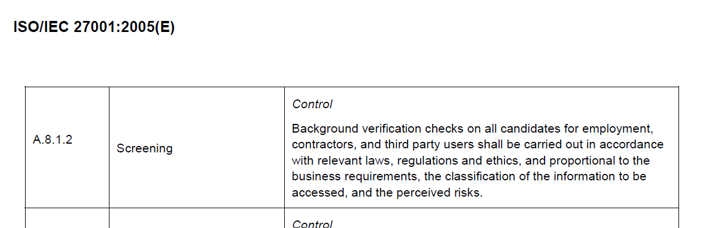
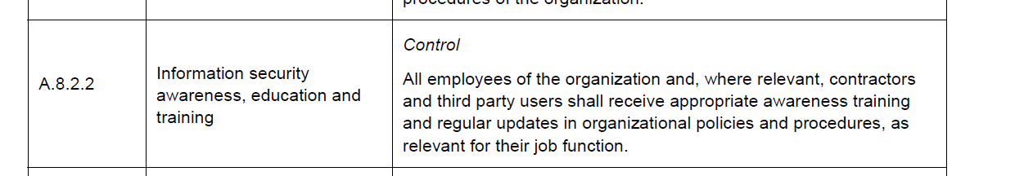
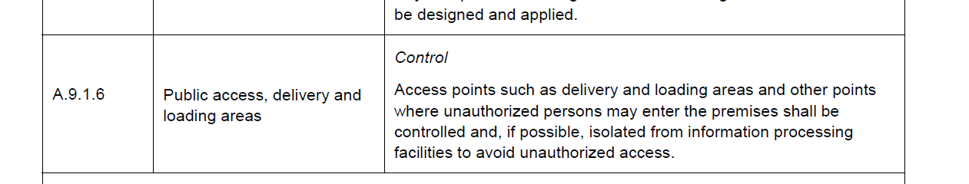

Slide 13
How are standards helpful
A standard helps to ensure an efficient and effective process resulting in reliable products or services.
Standards are updated as and when required to be embedded within the current environment.

Slide 14
Policies
Policies are the high-level statements of management intent, expectations and direction.
There can be multiple policies at the corporate level as well as the department level. It should be ensured that department-wise, policies are consistent and aligned with corporate-level policies.
Policies should be reviewed at periodic intervals to incorporate new processes, technology, and regulatory requirements. The appropriate version history should be maintained.
IS auditors should use policies to evaluate and verify compliance.

Slide 15
Procedures
Detailed actions and steps to support policy objectives.
Policy is why.
Procedure is how.
Guidelines should contain information such as examples, suggestions, requirements, and other details for executing procedures

Slide 16
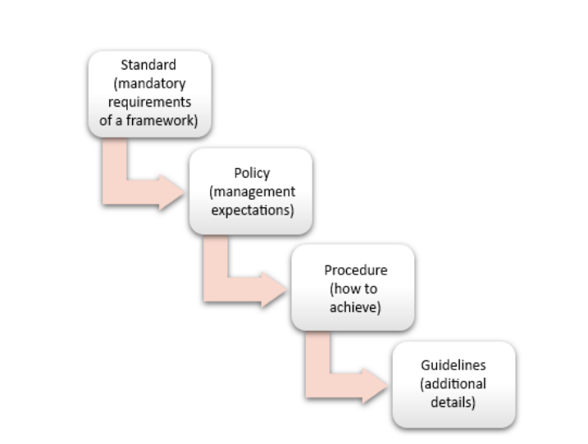

Slide 17
Information Security Policy
An information security policy is a set of rules and/or statements developed by an organization to protect its information and related technology.
Information security policies must balance the level of control with the level of productivity.
Must be approved by senior management / BOD

Slide 18
Content of the information security policy
A statement of management commitment vis-à-vis information security
Information security policies, principles, and compliance requirements
Information security awareness and training requirements for employees and third-party suppliers
Roles and responsibilities relating to information security
Business continuity arrangements
Reference to other relevant documents that supplements the information security policy.

Slide 19
Information Security policy
The policy should be disseminated to all end users. A relevant portion of information security requirements should also be made available to third-party suppliers.
Sign-off should be obtained from all employees and third parties having access to information assets regarding their readiness and preparedness to comply with the information security policy.
IS policy should be reviewed annually or when there are significant changes to the organization.

Slide 20
Info. Sec separate from IT
Information security management—This is a function that generally needs to be separate from the IT department and headed by a CISO. The CISO may report to the CIO or have a dotted-line (indirect reporting) relationship to the CIO.
Even when the security officer reports to the CIO, there is a possibility of conflict because the goals of the CIO are to efficiently provide continuous IT services whereas the CISO may be less interested in cost reduction if this impacts the quality of protection

